Slide 1
CLUSTERING UNIT 2
CLUSTERING
Prof. Vineeta Shrivastava
Assistant Professor
Department of Computer Science & Engineering
LNCT-E, Bhopal
Lakshmi Narain College of Technology Excellence, Bhopal

Slide 2
CLUSTERING UNIT 2
DATA CLUSTERING Hardcover – 21 August 2013 by Charu C. Aggarwal (Editor), Chandan K. Reddy (Editor)
Agenda
Density based clustering
Objectives
Algorithm
Advantages
Disadvantages
DBSCAN
Working/Algorithm
Advantages, Disadvantages
Numerical
Prof. Vineeta Shrivastava
Assistant Professor
Department of Computer Science & Engineering
LNCT-E, Bhopal
Lakshmi Narain College of Technology Excellence, Bhopal

Slide 3
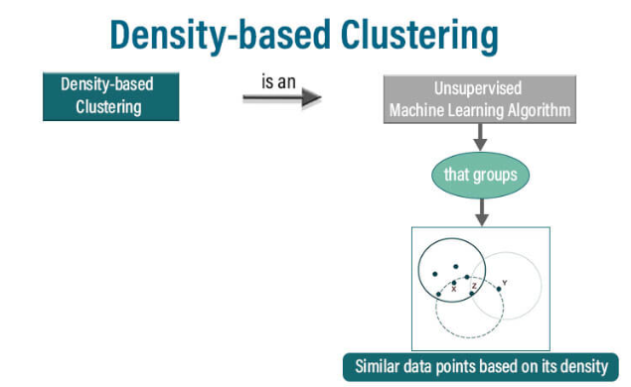
CLUSTERING UNIT 2
Density Based Clustering
Density-based clustering is a clustering algorithm that identifies clusters in data based on the density of data points in the feature space.
One of the most popular density-based clustering algorithms is DBSCAN (Density-Based Spatial Clustering of Applications with Noise).
Prof. Vineeta Shrivastava
Assistant Professor
Department of Computer Science & Engineering
LNCT-E, Bhopal
Lakshmi Narain College of Technology Excellence, Bhopal

Slide 4
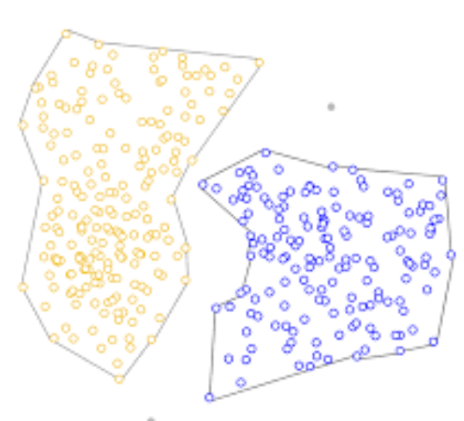
CLUSTERING UNIT 2
Density-based clustering aims to discover clusters of arbitrary shapes in spatial databases with noise. Unlike centroid-based algorithms (like k-means) that require a predetermined number of clusters, density-based methods can find clusters of varying shapes and sizes.
These methods are particularly useful for datasets where clusters have varying densities or contain noise
Prof. Vineeta Shrivastava
Assistant Professor
Department of Computer Science & Engineering
LNCT-E, Bhopal
Lakshmi Narain College of Technology Excellence, Bhopal

Slide 5
CLUSTERING UNIT 2
Objectives:
Identify clusters based on the density of data points.
Handle noise and outliers effectively.
Discover clusters of arbitrary shapes and sizes.
Automate the process of cluster determination without prior knowledge of the number of clusters.
Prof. Vineeta Shrivastava
Assistant Professor
Department of Computer Science & Engineering
LNCT-E, Bhopal
Lakshmi Narain College of Technology Excellence, Bhopal

Slide 6
CLUSTERING UNIT 2
Working:
Initialization: Select random unvisited point.
Expand Cluster: For each core point, expand the cluster by adding connected points to it until no more points can be added.
Noise Handling: Points that do not meet the criteria for core or border points are labeled as noise
Prof. Vineeta Shrivastava
Assistant Professor
Department of Computer Science & Engineering
LNCT-E, Bhopal
Lakshmi Narain College of Technology Excellence, Bhopal

Slide 7
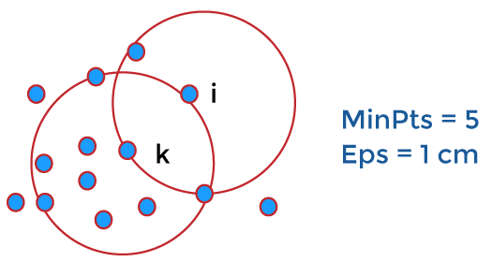
CLUSTERING UNIT 2
Terminologies
E_{PS}: It is considered as the maximum radius of the neighborhood.
MinPts: MinPts refers to the minimum number of points in an Eps neighborhood of that point.
NEps (i) : { k belongs to D and dist (i,k) < = Eps}
Directly density reachable:
A point i is considered as the directly density reachable from a point k with respect to Eps, MinPts if
i belongs to NEps(k)
Core point condition:
NEps (k) >= MinPts
Prof. Vineeta Shrivastava
Assistant Professor
Department of Computer Science & Engineering
LNCT-E, Bhopal
Lakshmi Narain College of Technology Excellence, Bhopal

Slide 8
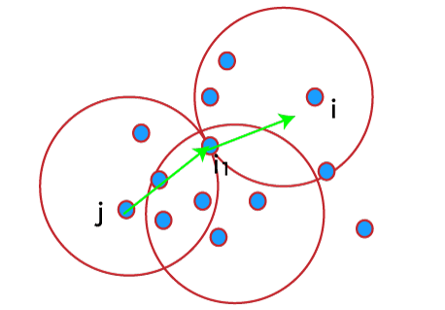
CLUSTERING UNIT 2
Density reachable:
A point denoted by i is a density reachable from a point j with respect to Eps, MinPts if there is a sequence chain of a point i1,…., in, i1 = j, pn = i such that i_{i} + 1 is directly density reachable from i_{i.}
Prof. Vineeta Shrivastava
Assistant Professor
Department of Computer Science & Engineering
LNCT-E, Bhopal
Lakshmi Narain College of Technology Excellence, Bhopal

Slide 9
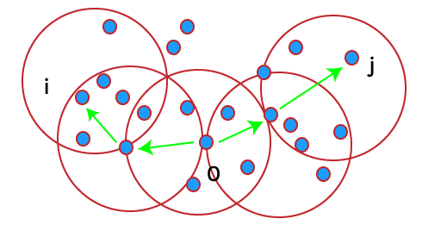
CLUSTERING UNIT 2
Density connected:
A point i refers to density connected to a point j with respect to Eps, MinPts if there is a point o such that both i and j are considered as density reachable from o with respect to Eps and MinPts.
Prof. Vineeta Shrivastava
Assistant Professor
Department of Computer Science & Engineering
LNCT-E, Bhopal
Lakshmi Narain College of Technology Excellence, Bhopal

Slide 10
CLUSTERING UNIT 2
Major Features of Density-Based Clustering
The primary features of Density-based clustering are given below.
It is a scan method.
It requires density parameters as a termination condition.
It is used to manage noise in data clusters.
Density-based clustering is used to identify clusters of arbitrary size.
Prof. Vineeta Shrivastava
Assistant Professor
Department of Computer Science & Engineering
LNCT-E, Bhopal
Lakshmi Narain College of Technology Excellence, Bhopal

Slide 11
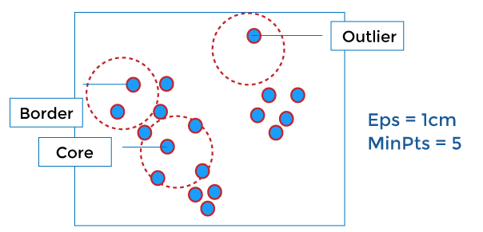
CLUSTERING UNIT 2
Density-Based Clustering Methods
DBSCAN
DBSCAN stands for Density-Based Spatial Clustering of Applications with Noise. It depends on a density-based notion of cluster. It also identifies clusters of arbitrary size in the spatial database with outliers.
Prof. Vineeta Shrivastava
Assistant Professor
Department of Computer Science & Engineering
LNCT-E, Bhopal
Lakshmi Narain College of Technology Excellence, Bhopal

Slide 12
CLUSTERING UNIT 2
DSBSCAN Clustering
Density-Based Spatial Clustering of Applications with Noise (DBSCAN) is a powerful density-based clustering algorithm designed to identify clusters in data by analyzing the density of points in a dataset.
Unlike traditional clustering algorithms like k-means, DBSCAN does not require the number of clusters to be specified in advance, making it particularly useful in exploratory data analysis.
Prof. Vineeta Shrivastava
Assistant Professor
Department of Computer Science & Engineering
LNCT-E, Bhopal
Lakshmi Narain College of Technology Excellence, Bhopal

Slide 13
CLUSTERING UNIT 2
It groups data points based on two key parameters epsilon which defines the neighborhood radius around each point, and minPts the minimum number of points required to form a dense region (a cluster). Points within dense regions are categorized as core points, while points in less dense areas are treated as border points or noise (outliers).
One of DBSCAN's key strengths is its ability to detect clusters of arbitrary shapes and handle noisy data effectively. This makes it especially useful for spatial data applications, but it can also be applied to non-spatial datasets for anomaly detection, pattern recognition, and more. However, its performance can be sensitive to the choice of epsilon and minPts and it may struggle with datasets containing clusters of widely varying densities.
Prof. Vineeta Shrivastava
Assistant Professor
Department of Computer Science & Engineering
LNCT-E, Bhopal
Lakshmi Narain College of Technology Excellence, Bhopal

Slide 14
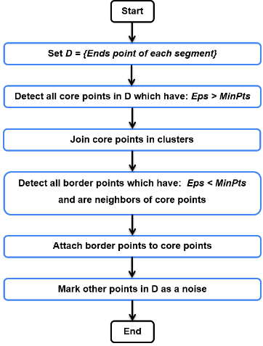
CLUSTERING UNIT 2
Working of DBSCAN:
Initialization: Select random unvisited point.
Expand Cluster: For each core point, expand the cluster by adding connected points to it until no more points can be added.
Noise Handling: Points that do not meet the criteria for core or border points are labeled as noise
Prof. Vineeta Shrivastava
Assistant Professor
Department of Computer Science & Engineering
LNCT-E, Bhopal
Lakshmi Narain College of Technology Excellence, Bhopal

Slide 15
CLUSTERING UNIT 2
Algorithm (DBSCAN):
Parameters: DBSCAN requires two parameters:(epsilon), which defines the radius of neighborhood around a point, and minPts which specifies the minimum number of points needed to form a dense region (core point).
Core Point: A point is a core point if at least minPts points are within its epsilon radius, including itself.
Border Point: A point is a border point if it lies within the epsilon adius of a core point but itself does not have minPts points within its own epsilon radius.
Noise Point: A point that is neither a core point nor a border point is considered noise (outlier)
Prof. Vineeta Shrivastava
Assistant Professor
Department of Computer Science & Engineering
LNCT-E, Bhopal
Lakshmi Narain College of Technology Excellence, Bhopal

Slide 16
CLUSTERING UNIT 2
Algorithm steps:
1. Choose ε (neighborhood radius) and MinPts (minimum points).
2. For each data point:
Find neighbors within ε.
Mark as core point if ≥ MinPts neighbors.
Mark as border point if < MinPts neighbors but near core point.
Mark as noise point otherwise.
3. Create clusters from core and border points.
Prof. Vineeta Shrivastava
Assistant Professor
Department of Computer Science & Engineering
LNCT-E, Bhopal
Lakshmi Narain College of Technology Excellence, Bhopal

Slide 17
CLUSTERING UNIT 2
Advantages:
Handles varying densities and shapes.
Robust to noise and outliers.
No fixed cluster shape or size.
Efficient for large datasets.
Disadvantages:
Sensitive to parameter selection (ε and MinPts).
Difficulty handling high-dimensional data.
Computationally expensive.
Prof. Vineeta Shrivastava
Assistant Professor
Department of Computer Science & Engineering
LNCT-E, Bhopal
Lakshmi Narain College of Technology Excellence, Bhopal

Slide 18
CLUSTERING UNIT 2
Applications:
Geographic Information Systems (GIS).
Image segmentation.
Gene expression analysis
Network analysis.
Anomaly detection.
Tools and Libraries:
scikit-learn (Python).
R (dbscan package).
MATLAB (dbscan function).
Weka (Java).
Prof. Vineeta Shrivastava
Assistant Professor
Department of Computer Science & Engineering
LNCT-E, Bhopal
Lakshmi Narain College of Technology Excellence, Bhopal

Slide 19
CLUSTERING UNIT 2
Numerical on DBSCAN Clustering
Apply the DBSCAN algorithm to the given data points and create the clusters with minPts =4 and epsilon =1.9.
Data Points
P1:(3,7)
P2:(4,6)
P3:(5,5)
P4:(6,4)
P5:(7,3)
P6:(6,2)
P7:(7,2)
P8:(8,4)
P9:(3,3)
P10:(2,6)
P11:(3,5)
P12:(2,4)
Prof. Vineeta Shrivastava
Assistant Professor
Department of Computer Science & Engineering
LNCT-E, Bhopal
Lakshmi Narain College of Technology Excellence, Bhopal

Slide 20

CLUSTERING UNIT 2
Using Euclidian distance formula and calculate distance between each point
Distance (A (x1,y1) ,B (x2,y2))=$\sqrt{{{(x}_{2}−x_{1})}^{2} +{{(y}_{2}−y_{1})}^{2}}$
Prof. Vineeta Shrivastava
Assistant Professor
Department of Computer Science & Engineering
LNCT-E, Bhopal
Lakshmi Narain College of Technology Excellence, Bhopal

Slide 21
minPts =4 and epsilon =1.9
P1:(3,7)
P2:(4,6)
P3:(5,5)
P4:(6,4)
P5:(7,3)
P6:(6,2)
P7:(7,2)
P8:(8,4)
P9:(3,3)
P10:(2,6)
P11:(3,5)
P12:(2,4)
CLUSTERING UNIT 2
 | P1 | P2 | P3 | P4 | P5 | P6 | P7 | P8 | P9 | P10 | P11 | P12
P1 | 0
P2 | 1.41 | 0
P3 | 2.83 | 1.41 | 0
P4 | 4.24 | 2.83 | 1.41 | 0
P5 | 5.66 | 4.24 | 2.83 | 1.41 | 0
P6 | 5.83 | 4.47 | 3.16 | 2.00 | 1.41 | 0
P7 | 6.40 | 5.00 | 3.61 | 2.24 | 1.00 | 1.00 | 0
P8 | 5.83 | 4.47 | 3.16 | 2.00 | 1.41 | 2.83 | 2.24 | 0
P9 | 4.00 | 3.16 | 2.83 | 3.16 | 4.00 | 3.16 | 4.12 | 5.10 | 0
P10 | 1.41 | 2.00 | 3.16 | 4.47 | 5.83 | 5.66 | 6.40 | 6.32 | 3.16 | 0
P11 | 2.00 | 1.41 | 2.00 | 3.16 | 4.47 | 4.24 | 5.00 | 5.10 | 2.00 | 1.41 | 0
P12 | 3.16 | 2.83 | 3.16 | 4.00 | 5.10 | 4.47 | 5.39 | 6.00 | 1.41 | 2.00 | 1.41 | 0
P1: P2,P10
P2: P1,P3,P11
P3: P2,P4
P4: P3,P5
P5: P4,P6,P7,P8
P6: P5,P7
P7: P5,P6
P8: P5
P9: P12
P10: P1,P11
P11: P2,P10,P12
P12: P9,P11
Prof. Vineeta Shrivastava
Assistant Professor
Department of Computer Science & Engineering
LNCT-E, Bhopal
Lakshmi Narain College of Technology Excellence, Bhopal

Slide 22
CLUSTERING UNIT 2
minPts =4 and epsilon =1.9
P1: P2,P10
P2: P1,P3,P11
P3: P2,P4
P4: P3,P5
P5: P4,P6,P7,P8
P6: P5,P7
P7: P5,P6
P8: P5
P9: P12
P10: P1,P11
P11: P2,P10,P12
P12: P9,P11
Points | Status
P1 |  | Border
P2 | Core
P3 |  | Border
P4 |  | Border
P5 | Core
P6 |  | Border
P7 |  | Border
P8 |  | Border
P9
P10 |  | Border
P11 | Core
P12 |  | Border
P9 is outlier or noise bcz it is not part of core or border point
Prof. Vineeta Shrivastava
Assistant Professor
Department of Computer Science & Engineering
LNCT-E, Bhopal
Lakshmi Narain College of Technology Excellence, Bhopal

Slide 23
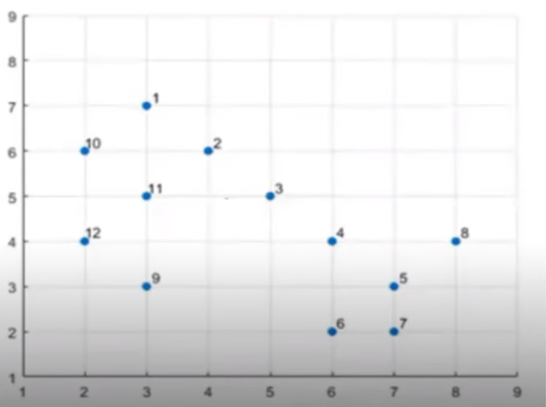
CLUSTERING UNIT 2
P1: P2,P10
P2: P1,P3,P11
P3: P2,P4
P4: P3,P5
P5: P4,P6,P7,P8
P6: P5,P7
P7: P5,P6
P8: P5
P9: P12
P10: P1,P11
P11: P2,P10,P12
P12: P9,P11
Prof. Vineeta Shrivastava
Assistant Professor
Department of Computer Science & Engineering
LNCT-E, Bhopal
Lakshmi Narain College of Technology Excellence, Bhopal

Slide 24
CLUSTERING UNIT 2
THANKYOU
Prof. Vineeta Shrivastava
Assistant Professor
Department of Computer Science & Engineering
LNCT-E, Bhopal
Lakshmi Narain College of Technology Excellence, Bhopal

